Slide 1
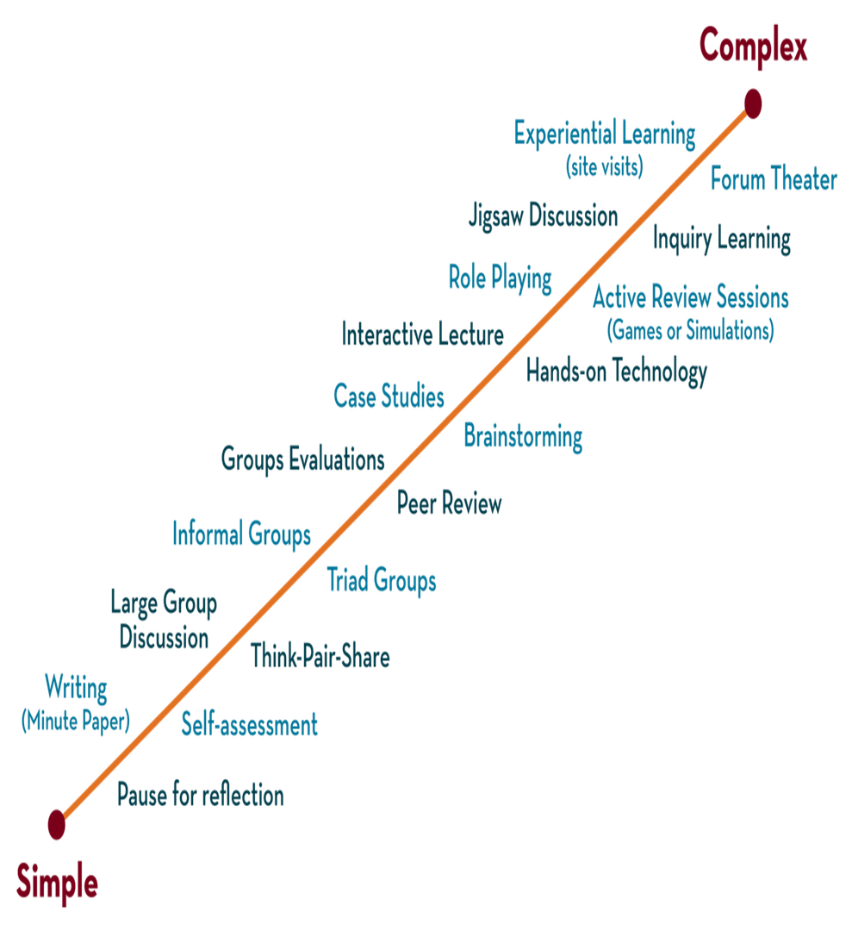
Department of CSE
DESIGN AND ANALYSIS OF ALGORITHMS
24CS2203
Topic:
Divide and Conquer
Merge Sort

Slide 2
Merge Sort
Merge Sort is a Divide and Conquer algorithm.
It divides input array in two halves, calls itself for the two halves and then merges the two sorted halves.
The merge() function is used for merging two halves.
The merge(arr, l, m, r) is key process that assumes that arr[l..m] and arr[m+1..r] are sorted and merges the two sorted sub-arrays into one.
Best case | O(nlogn)
Average case | O(nlogn)
Worst case | O(nlogn)
Memory | n
Stable | YES
Inplace | NO

Slide 3
Algorithm D and C(P) { if small(P) then return S(P) else { divide P into smaller instances P1 ,P2 .....Pk apply D and C to each sub problem return combine (D and C(P1)+ D and C(P2)+.......+D and C(Pk)) } }
Algorithm

Slide 4
EXAMPLE
i=start; k=0; j=mid+1
start
end
0 | 1 | 2 | 3 | 4 | 5 | 6 | 7 | 8
2 | 4 | 6 | 8 | 9 | 3 | 5 | 7 | 10
arr
i
m
j
If arr[i]<=arr[j] then temp[k]=arr[i], k++, i++
0 | 1 | 2 | 3 | 4 | 5 | 6 | 7 | 8
2
temp
k

Slide 5
0 | 1 | 2 | 3 | 4 | 5 | 6 | 7 | 8
2 | 4 | 6 | 8 | 9 | 3 | 5 | 7 | 10
arr
i
m
j
If arr[i]>arr[j] then temp[k]=arr[j], k++, j++
0 | 1 | 2 | 3 | 4 | 5 | 6 | 7 | 8
2 | 3
temp
k

Slide 6
0 | 1 | 2 | 3 | 4 | 5 | 6 | 7 | 8
2 | 4 | 6 | 8 | 9 | 3 | 5 | 7 | 10
arr
i
m
j
If arr[i]<=arr[j] then temp[k]=arr[i], k++, i++
0 | 1 | 2 | 3 | 4 | 5 | 6 | 7 | 8
2 | 3 | 4
temp
k

Slide 7
0 | 1 | 2 | 3 | 4 | 5 | 6 | 7 | 8
2 | 4 | 6 | 8 | 9 | 3 | 5 | 7 | 10
arr
i
m
j
If arr[i]>arr[j] then temp[k]=arr[j], k++, j++
0 | 1 | 2 | 3 | 4 | 5 | 6 | 7 | 8
2 | 3 | 4 | 5
temp
k

Slide 8
0 | 1 | 2 | 3 | 4 | 5 | 6 | 7 | 8
2 | 4 | 6 | 8 | 9 | 3 | 5 | 7 | 10
arr
i
m
j
If arr[i]<=arr[j] then temp[k]=arr[i], k++, i++
0 | 1 | 2 | 3 | 4 | 5 | 6 | 7 | 8
2 | 3 | 4 | 5 | 6
temp
k

Slide 9
0 | 1 | 2 | 3 | 4 | 5 | 6 | 7 | 8
2 | 4 | 6 | 8 | 9 | 3 | 5 | 7 | 10
arr
i
m
j
If arr[i]>arr[j] then temp[k]=arr[j], k++, j++
0 | 1 | 2 | 3 | 4 | 5 | 6 | 7 | 8
2 | 3 | 4 | 5 | 6 | 7
temp
k

Slide 10
0 | 1 | 2 | 3 | 4 | 5 | 6 | 7 | 8
2 | 4 | 6 | 8 | 9 | 3 | 5 | 7 | 10
arr
i
m
j
If arr[i]<=arr[j] then temp[k]=arr[i], k++, i++
0 | 1 | 2 | 3 | 4 | 5 | 6 | 7 | 8
2 | 3 | 4 | 5 | 6 | 7 | 8
temp
k

Slide 11
0 | 1 | 2 | 3 | 4 | 5 | 6 | 7 | 8
2 | 4 | 6 | 8 | 9 | 3 | 5 | 7 | 10
arr
m
j
i
If arr[i]<=arr[j] then temp[k]=arr[i], k++, i++
0 | 1 | 2 | 3 | 4 | 5 | 6 | 7 | 8
2 | 3 | 4 | 5 | 6 | 7 | 8 | 9
temp
k

Slide 12
0 | 1 | 2 | 3 | 4 | 5 | 6 | 7 | 8
2 | 4 | 6 | 8 | 9 | 3 | 5 | 7 | 10
arr
m
i
j
As i>mid; loop breaks. Check j<=end. If not, temp[k]=arr[j], k++, j++
0 | 1 | 2 | 3 | 4 | 5 | 6 | 7 | 8
2 | 3 | 4 | 5 | 6 | 7 | 8 | 9 | 10
temp
k
The final sorted list

Slide 13
Algorithm
Algorithm MergeSort ( low, high)
// a[low: high] is a global array to be sorted.
// Small(P) is true if there is only one element to sort. In this case the list is already sorted.
{ if ( low<high ) then // if there are more than one element
{
// Divide P into sub problems.
// Find where to split the set.
mid := [(low+high)/2];
//solve the sub problems.
MergeSort(low,mid);
MergeSort(mid+1, high);
// Combine the solutions.
Merge(low, mid, high);
}
}
Recursive Calls

Slide 14
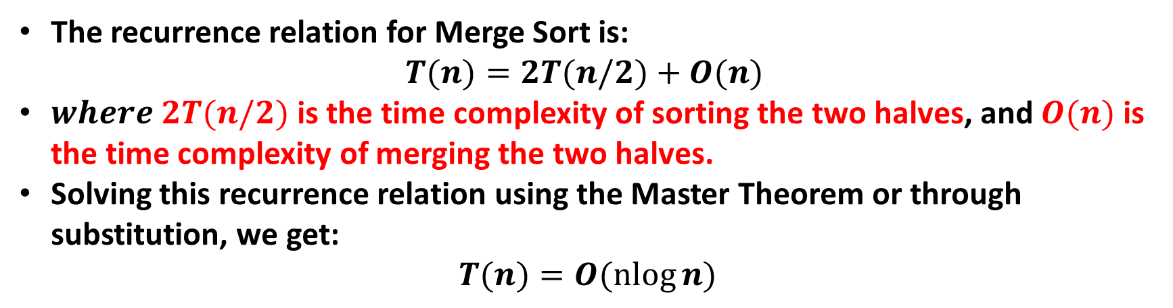
Time Complexity
The recurrence relation for Merge Sort is:
$$T(n)=2T(n/2)+O(n)$$
$where 2T(n/2)$is the time complexity of sorting the two halves, and $O(n)$is the time complexity of merging the two halves.
Solving this recurrence relation using the Master Theorem or through substitution, we get:
$$T(n)=O(nlog⁡n)$$

